Slide 1

Workshop Data in use Protection Compass Keep the cape in the Cloud and on the Edge Wrap-up and next steps for the workshop
N
Version 1.0 (Alpha) – June 2020
https://aka.ms/DataInUseProtectionWS
Notes:
This presentation is shared under the license "Attribution 4.0 International (CC BY 4.0)". To see a copy of this license, visit https://creativecommons.org/licenses/by/4.0/legalcode or write to Creative Commons, PO Box 1866, Mountain View, CA 94042 USA
Microsoft, Windows, Microsoft Azure and/or other Microsoft products and services referenced in the documentation may be either trademarks or registered trademarks of Microsoft in the United States and/or other countries. The licenses for this project do not grant you rights to use any Microsoft names, logos, or trademarks. Microsoft's general trademark guidelines can be found at http://go.microsoft.com/fwlink/?LinkID=254653.
Privacy information can be found at https://privacy.microsoft.com/en-us/
Microsoft and any contributors reserve all other rights, whether under their respective copyrights, patents, or trademarks, whether by implication, estoppel or otherwise.
MICROSOFT AND ANY CONTRIBUTORS MAKE NO WARRANTIES, EXPRESS, IMPLIED OR STATUTORY, AS TO THE INFORMATION IN THIS PRESENTATION.

Slide 2
Data in use Protection Workshop
Typical Schedule
Typical Stakeholders
Executive Summary + Your goals and strategy
Leadership Kickoff and Closeout
Chief Digital Officer (CDO), Chief Information Officer (CIO), Chief Information & Security Officer (CISO), Others as needed
Data in use Protection Fundamentals
Optional PARTICIPATION
Critical Design Decisions
Architecture & Technical Team Stakeholders
Governance Teams, Risk and Compliance Team(s), Operations Teams, and Business Stakeholders
Technical Illustrations and Hands-On Labs
Planning Next Steps
We are here
WORKSHOP OBJECTIVE: Learn how to adequately preserve the confidentiality and integrity of your (most) sensitive data while being in use, as well as the ones of your IP you most value both in the Cloud and in the Edge

Slide 3
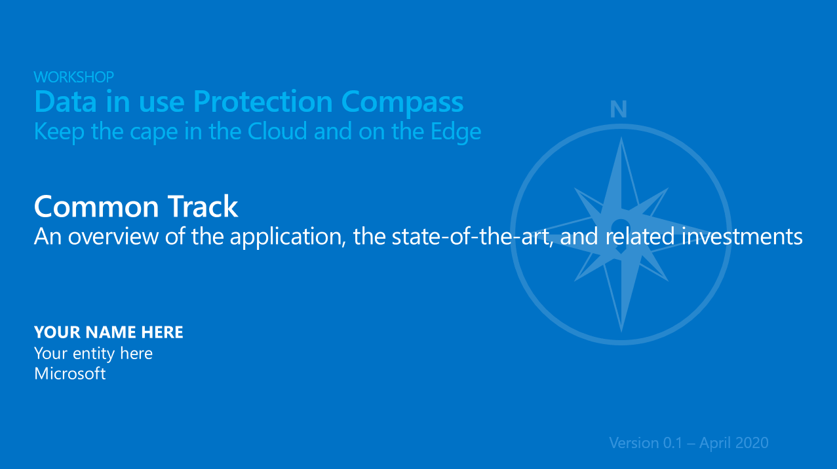
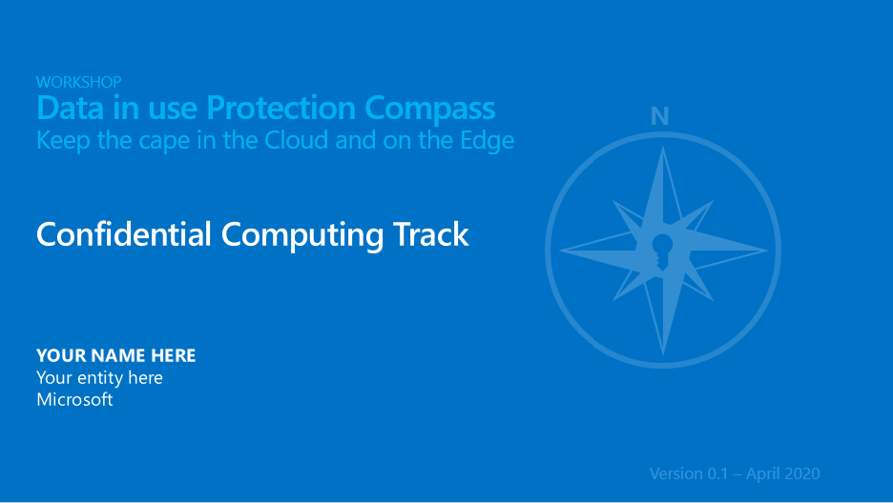
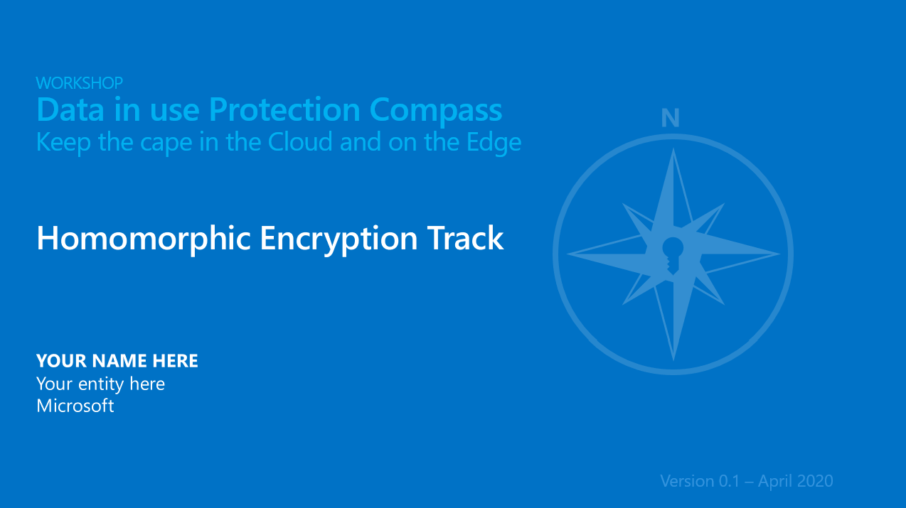
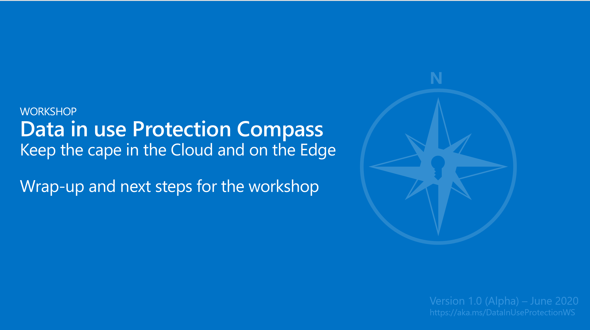
A compass for protecting your (most) sensitive data
A common track
A series of additional Specific tracks
We are here
Applicable techniques for data in use protection
Can serve as a guide to help inform on state-of-the-art and align specific investments, technical skills, and related toolchains to sustain your sensitive workloads in the Cloud and on the Edge
Guide decisions regarding the proper level of protection of your (most) sensitive data and/or the IP you most value
A Wrap-UP and SPECIFIC PERSPECTIVES
Confidential Computing Track
Homomorphic Encryption Track
+ Hands-On Labs
+ Hands-On Labs
Notes:
Important:
In order to make the presentation more dynamic and exciting, we are using Zoom for PowerPoint.
You can jump to and from specific slides, sections, and portions of the workshop in an order you decide while you're presenting.
For best results, use Office 365 and PowerPoint 2019.

Slide 4
Risks covered by discussed techniques A synthesis attempt ;-)
Technique Risks | Confidential Computing | Homomorphic Encryption | Multi-Party Computing | Differential Privacy
Malicious Priviledged Admin from Cloud Provider | ✔ | ✔ | ✔ | ✘
Malicious Priv Insider from Customer | ✔ | ✔ | ✔ | ✘
Malicious Priviledged Party (Collusion) | ✔ | NA | ✔* | NA
Hackers exploiting bugs in the fabric (HW or SW) | ✔* TCB, side-channel | ✔ | ✔* | NA
Hackers exploiting bugs in the code | ✘ | NA | NA | ✘
3rd parties accessing data without customer consent | ✔ | ✔* | ✔ | ✔
Loss of control over data due to sharing | ✔ | NA | ✔ | ✔
Lost of control over data due to legal requirement | ✔ | ✔ | ✔ | ✘
Data theft | ✔ | ✔ | ✔ | ✔
Data leak | NA | NA | NA | ✔

Slide 5
Confidential Computing Technique sum-up
PROS
Operations done on plaintext; therefore arbitrary computations possible
Lift & Shift model
Using attestations, possible to create collaborative pipeline
CONS
Subject to side-channel attacks
Still a piece of hardware part of the TCB
Hard to write secure software (new or refactored application)

Slide 6
Homomorphic encryption Technique sum-up
PROS
Strong security basis
Minimal TCB with little setup required
Little communication
CONS
Not IND-CCA (vulnerable to chosen-ciphertext attacks)
No integrity check
Only addition and multiplication with limited depth in practice

Slide 7
Secure Multi-Party Computing Technique sum-up
PROS
Possibility to collaborate
More operations available than HE
Illimited number of operations (e.g. multiplications)
CONS
Higher communication cost
Need to be online
Need to have a trusted third party to provide randomness for secure sharing

Slide 8
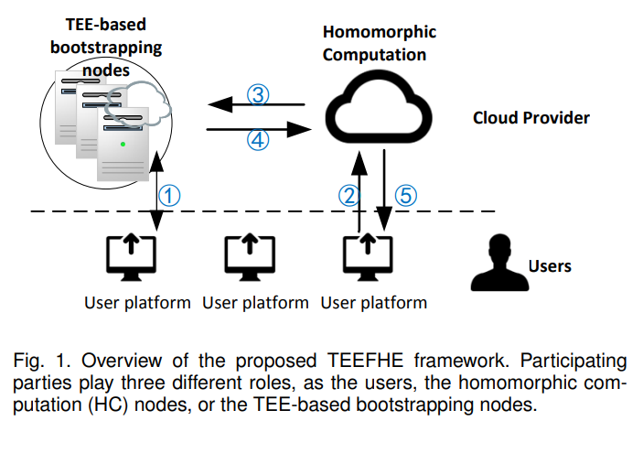
Combining techniques A winning formula?
Associating several techniques together allows to associate their advantages, and to offset their drawbacks
However, a bad implementation could have the opposite effect.
Ongoing research explores the possible winning associations. Here are some promising solutions:
Source: Toward Scalable Fully Homomorphic Encryption Through Light Trusted Computing Assistance
CC & SMPC
TEEs can serve as random generators for a secure SMPC.
HE & SMPC
Some protocols leveraging homomorphic encryption already allow to perform some secure multi-party computation. Homomorphic encryption can also be multi-key with a limited number of participants.
CC & HE
The TEEFHE approach provides confidentiality and privacy for data in use: it brings a better performance (than FHE-only) and is more secure than a TEE-only approach.
Another approach provides the high confidentiality and privacy standards of HE and the integrity of CC.

Slide 9
Differential Privacy Technique sum-up
PROS
Hides individual contribution in statistics
Level of desired precision can be set (knowing the number of queries)
CONS
Limited privacy budget
Loss of precision
Note Differential Privacy is not sufficient for secure computation as it is its purpose. It is a different but efficient additional mechanism for hiding the possibly sensitive aspect of the result of a query.

Slide 10
Data in use protection AI/ML scenarios
Query & Encrypted search
Analytics
Computing
Data collection & storage
Data processing
Training
Data & AI
Inference
Data at rest Data in transit
Data in use
Scenarios in which differential privacy can be used
Step | Confidential Computing | Homomorphic Encryption | Multi-Party Computing
Computing | ✔ | ✔ | ✔
Training | ✔ | ✘ | ✔
Inference | ✔ | ✔ | ✔

Slide 11
As a conclusion
A review and comparison of our 3 main subjects
 | Confidential Computing (CC) (w/ secure hardware) | Homomorphic Encryption (HE) | Secure Multi-Party Computation (MPC)
Bottleneck | - | Compute-bound | Network-bound
Privacy | Trusted Hardware | Encryption | Encryption / Non-collusion
Non-interactive | ✔ | ✔ | ✘
Cryptographic security | ✘ (known attacks) | ✔ | ✔
Short comings | Different Security Model Side-Channel Attacks | High Computation Overhead | High Communication High Number of Interactions

Slide 12
Encryption technologies in transit and at rest in Azure
Feature | Access to customer data by a rogue administrator (Cloud provider) | Data Theft | Data Leakage
Encryption of communications with TLS |  | ● | ●
Azure Disk Encryption (IaaS) |  | ●
Client-Side Encryption for Microsoft Azure Storage | ● | ●
Azure storage encryption (service level) |  | ●
Transparent Data Encryption – Azure SQL |  | ●
Always Encrypted – Azure SQL | ● | ●
Risks
Notes:
Title: Encryption technologies in Azure
Objectives: Show what risks are covered by technologies
Description
The table details the three main risks covered or not in function of technology
The ability for a malicious administrator on the cloud provider's side to access data
The risk of information theft that one associates with a specifically malicious action
Information leakage that is associated to an involuntary action resulting in the dissemination of information beyond authorized boundaries
We can notice that:
All encryption solutions protect against information theft; indeed, since the data is encrypted at rest on, the theft of media does not allow access to the data they host.
Encryption of communications with TLS protects data in transit against interception that would lead to theft or leakage of information
The risk of information leakage is not covered by the last 4 solutions as an authorized user can access the data in clear text and unintentionally copy or send it
Logically, only the 2 encrypting the data at the client-side are those that protect against a malicious administrator of the cloud provider at the expense of a potential loss of functionality;
as data is encrypted before being copied to the cloud, it is NOT available unencrypted on the drive or in memory from the cloud service.

Slide 13
Attacks covered by Privacy Preserving technologies
Technique Attacks | Confidential Computing | Homomorphic Encryption | Multi-Party Computing | Differential Privacy
Model Inversion through targeted queries | NA | NA | NA | ✔
Membership Inference Attack | NA | NA | NA | ✔
Attacks coming from a malicious host provider | ✔ | ✔ | ✔ | NA
Software exploits using hardware vulnerabilities | ✘ | ✔ | ✔ | ✔

Slide 14
Other areas to be covered
Responsible AI and responsible ML: Data model protection and control
See
Failure Modes in Machine Learning, Threat Modeling AI/ML Systems and Dependencies
Data Poisoning during training
Adversarial Perturbation in a query
Traditional software exploits
Attacking ML supply chain
Traditional software exploits
Model Stealing through targeted queries
Notes:
Failure Modes in Machine Learning: https://docs.microsoft.com/en-us/security/engineering/failure-modes-in-machine-learning
Threat Modeling AI/ML Systems and Dependencies: https://docs.microsoft.com/en-us/security/engineering/threat-modeling-aiml

Slide 15
Other areas to be covered
The data protection requires a comprehensive end-to-end approach
Encrypt Data
Protect encryption keys, back up data
Access control
Data
Review of permissions/access, protection of identities, strong authentication, conditional access control, etc.
100101100101 011010 011010 100101100101 011010 011010 100101100101 011010 011010 100101100101 011010 011010
Protect administration computers
Device security hardening, anti-malware protection, device health check, etc.
Notes:
Title: Other areas to be covered
Objectives: Show what other protections are necessary beyond encryption
Description
With respect to the residual risks described earlier, the slide illustrates that the protections should be positioned
At the data level with encryption but also using backups for the data itself and also encryption keys
At the level of the data access: a rigorous and audited access control is required to ensure that only authorized persons will have access and be able to detect suspicious behavior that might indicate identity theft
Finally, it is important to strengthen security for devices used by people with privileges (e.g. administrators in charge of access control or keys management)

Slide 16
N
Whiteboard and Q&A

Slide 17

Thanks!

Slide 18


https://aka.ms/DataInUseProtectionWS
Attribution 4.0 International
(CC BY 4.0)
This presentation is shared under the license "Attribution 4.0 International (CC BY 4.0)". To see a copy of this license, visit https://creativecommons.org/licenses/by/4.0/legalcode or write to Creative Commons, PO Box 1866, Mountain View, CA 94042 USA

